Slide 1
Regression Analysis
Simple Linear Regression
Nicoleta Serban, Ph.D.
Professor
School of Industrial and Systems Engineering
Regression Concepts:
Statistical Inference

Slide 2

About This Lesson

Slide 3



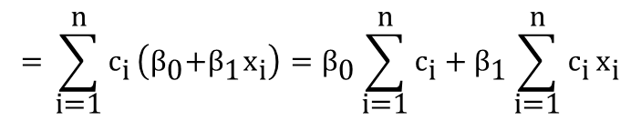
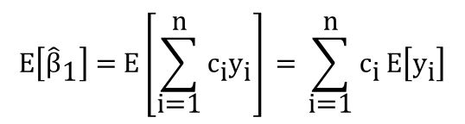


Regression Estimators: Properties
For the slope parameter $\text{β}$₁, we can show
$\text{E}\text{(}{\hat{\text{β}}}_{\text{1}}\text{)}$ = $\text{β}$₁
Var$\text{(}{\hat{\text{β}}}_{\text{1}}\text{)}\text{ =} σ\text{2}\text{ / }\text{S}\text{xx}$
${\hat{\text{β}}}_{\text{1}}=\frac{\sum{\left({\text{x}}_{\text{i}}\text{−}\overline{\text{x}}\right){\text{Y}}_{\text{i}}}}{{\text{S}}_{\text{xx}}}$ but ${\text{x}}_{\text{i}}$ fixed → $\frac{{\text{x}}_{\text{i}}\text{−}\overline{\text{x}}}{{\text{S}}_{\text{xx}}}\text{ = }{ \text{c}}_{\text{i}}$fixed
$$\text{Ε}\left[{\hat{\text{β}}}_{\text{1}}\right]\text{ = }\text{Ε}\left[\sum_{\text{i}\text{=1}}^{\text{n}}{{\text{c}}_{\text{i}}{\text{y}}_{\text{i}}}\right]\text{ =} \sum_{\text{i}\text{=1}}^{\text{n}}{{\text{c}}_{\text{i}}}\text{Ε}\left[{\text{y}}_{\text{i}}\right]$$
$$\text{=} \sum_{\text{i}\text{=1}}^{\text{n}}{{\text{c}}_{\text{i}}}\left({\text{β}}_{\text{0}}\text{+}{\text{β}}_{\text{1}}{\text{x}}_{\text{i}}\right)={\text{β}}_{\text{0}}\sum_{\text{i}\text{=1}}^{\text{n}}{{\text{c}}_{\text{i}}}+{\text{β}}_{\text{1}}\sum_{\text{i}\text{=1}}^{\text{n}}{{\text{c}}_{\text{i}}}{\text{x}}_{\text{i}}$$
= 0
= 1
$$\text{=} {\text{β}}_{\text{1}}\text{→} \text{Ε}\left[{\hat{\text{β}}}_{\text{1}}\right] \text{=} {\text{β}}_{\text{1}}$$

Slide 4

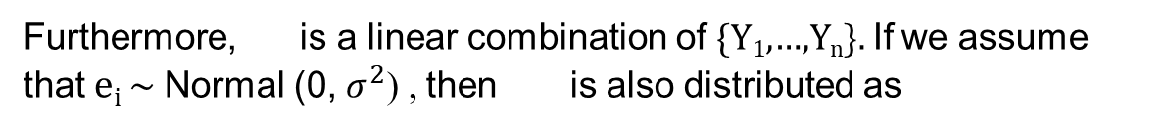
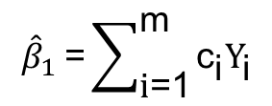


Regression Estimators: Properties
$${\hat{β}}_{1}$$
Furthermore, is a linear combination of {Y₁,…,Y_{n}}. If we assume that e_{i} ~ Normal (0, $σ^{2}$) , then is also distributed as
$${\hat{β}}_{1}$$
$${\hat{β}}_{1} \text{=}\sum_{\text{i}\text{=1}}^{\text{m}}{{\text{c}}_{\text{i}}{\text{Y}}_{\text{i}}}$$
a linear combination of normally distributed random variables
$${\hat{β}}_{1}$$
~ Normally distributed

Slide 5

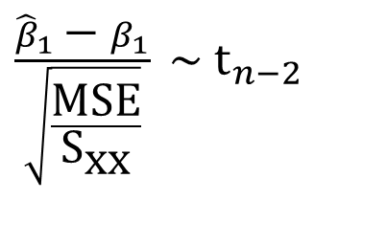
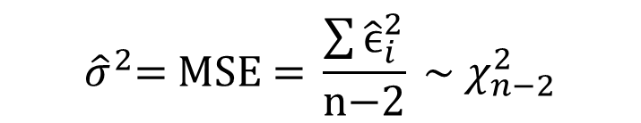

Regression Estimators: Properties
Sampling Distribution of ${\hat{β}}_{1}$:
We do not know $σ^{2}$. We can replace it by MSE, but then the sampling distribution becomes the t-distribution with n-2 df.
$${\hat{β}}_{1} \sim N(β_{1},\frac{σ^{2}}{S_{XX}})$$
$\frac{{\hat{β}}_{1} \text{−} β_{1}}{\sqrt{\frac{\text{MSE}}{{\text{S}}_{\text{xx}}}}} \sim$ $t_{n−2}$
$${\hat{σ}}^{2}\text{= }\text{MSE}\text{ = }\frac{\sum{{\hat{\text{ϵ}}}_{i}^{2}}}{\text{n}\text{−2}} \text{\sim } χ_{n−2}^{2}$$

Slide 6
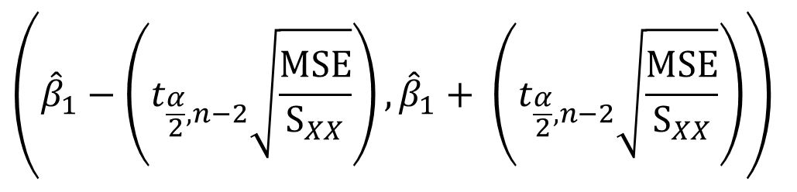

Inference for Slope Parameter
Given the sampling distribution of ${\hat{β}}_{1}$, we can derive confidence intervals and perform hypothesis testing for $β_{1}$:
$$\left({\hat{β}}_{1}−\left(t_{\frac{α}{2},n−2}\sqrt{\frac{MSE}{S_{XX}}}\right), {\hat{β}}_{1}+ \left(t_{\frac{α}{2},n−2}\sqrt{\frac{MSE}{S_{XX}}}\right)\right)$$

Slide 7
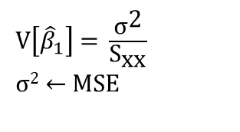

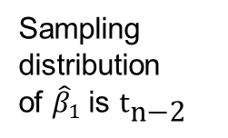
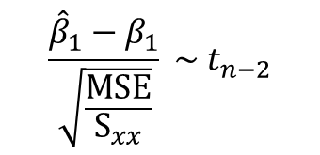
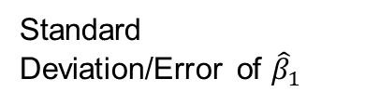
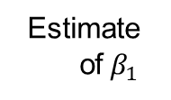
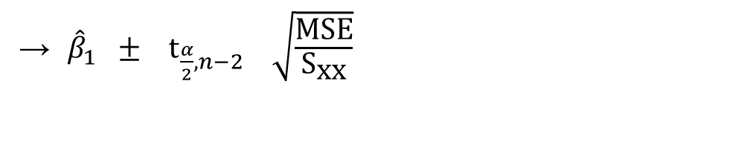
Confidence Interval Derivation
$$\frac{{\hat{β}}_{1}−β_{1}}{\sqrt{\frac{MSE}{S_{xx}}}} \sim t_{n−2}$$
t–interval for $β_{1}$
→ ${\hat{β}}_{1} ± {\text{t}}_{\frac{α}{2}, n−2} \sqrt{\frac{\text{MSE}}{{\text{S}}_{\text{xx}}}}$
1 - α
Confidence interval
Estimate
of${ β}_{1}$
t-critical
point
Standard Deviation/Error of ${\hat{β}}_{1}$
Sampling distribution
of ${\hat{β}}_{1}$is ${\text{t}}_{\text{n}\text{−2}}$
V$\left[{\hat{β}}_{1}\right] \text{= }\frac{{\text{σ}}^{\text{2}}}{{\text{S}}_{\text{xx}}}$
$\text{σ}$²$\text{←} \text{MSE}$

Slide 8
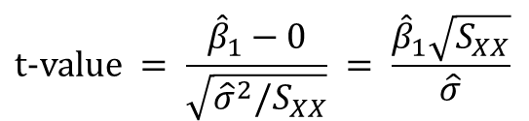
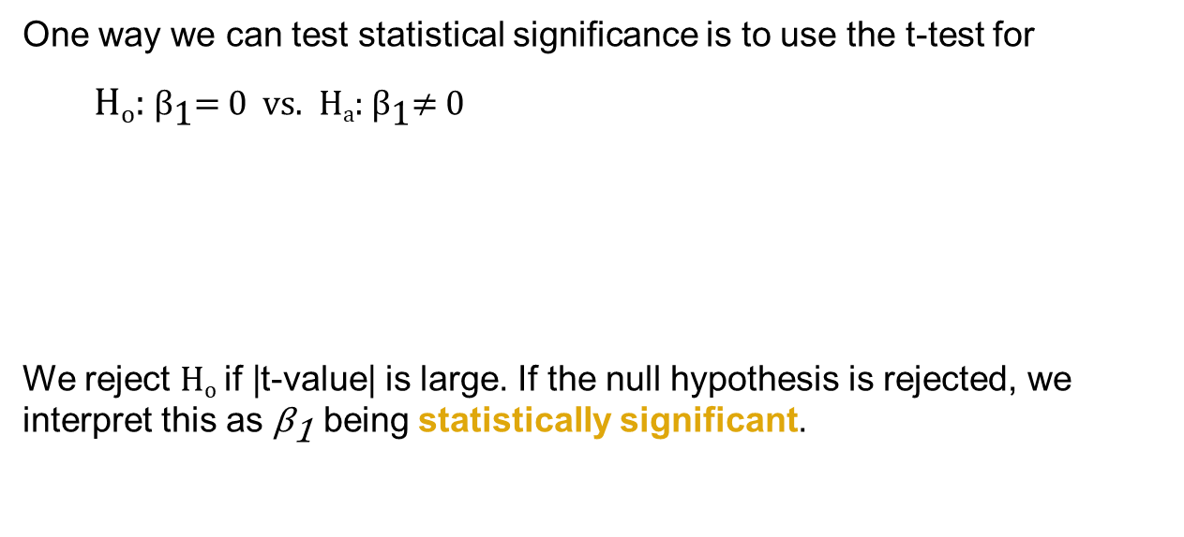
Testing the Overall Regression
One way we can test statistical significance is to use the t-test for
H_{o}: ${\text{β}}_{\text{1}}$= 0 vs. H_{a}: ${\text{β}}_{\text{1}}$≠ 0
We reject H_{o} if |t-value| is large. If the null hypothesis is rejected, we interpret this as ${\text{β}}_{\text{1}}$ being statistically significant.
$$\text{t}\text{−}\text{value} = \frac{{\hat{β}}_{1}−0}{\sqrt{{\hat{σ}}^{2}/S_{XX}}} = \frac{{\hat{β}}_{1}\sqrt{S_{XX}}}{\hat{σ}}$$

Slide 9

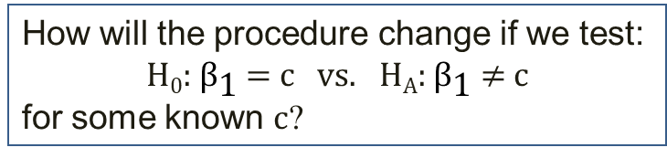
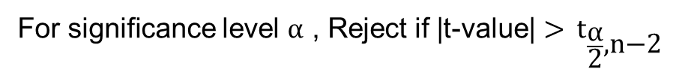
Testing Regression at Different Levels
How will the procedure change if we test:
H₀: ${\text{β}}_{\text{1}}$ = c vs. H_{A}: ${\text{β}}_{\text{1}}$ ≠ c
for some known c?
t-value = $\frac{{\hat{\text{β}}}_{1}\text{−}\text{c}}{\text{se}\left({\hat{\text{β}}}_{1}\right)}$ how large to reject H₀: $β_{1}$= c ?
For significance level $α$ , Reject if |t-value| > ${\text{t}}_{\frac{\text{α}}{\text{2}}\text{,}\text{n}\text{−2}}$
Alternatively, compute P-value = 2P(T_{n-2} > |t-value|)
If P-value small (p-value < 0.01) Reject

Slide 10
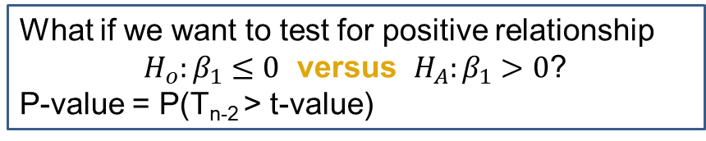
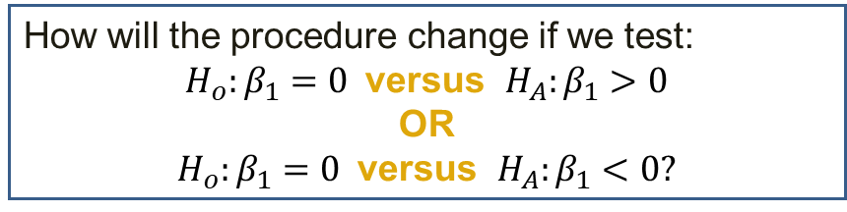
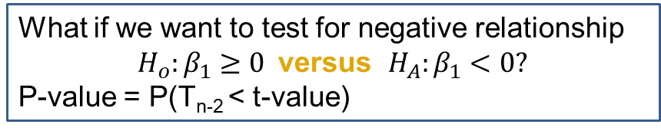
Testing Regression at Different Levels (cont’d)
How will the procedure change if we test:
$H_{o}:β_{1}=0$ versus $H_{A}:β_{1}>0$
OR
$H_{o}:β_{1}=0$ versus $H_{A}:β_{1}<0$?
What if we want to test for positive relationship
$H_{o}:β_{1}≤0$ versus $H_{A}:β_{1}>0\text{?}$
P-value = P(T_{n-2} > t-value)
What if we want to test for negative relationship
$H_{o}:β_{1}≥0$ versus $H_{A}:β_{1}<0?$
P-value = P(T_{n-2} < t-value)

Slide 11


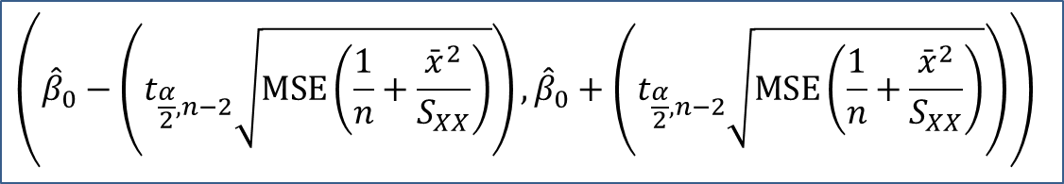
Inference for Intercept Parameter
${\hat{β}}_{0}=\overline{Y}−$ ${\hat{β}}_{1}$ $\overline{x}$
$E\left({\hat{β}}_{0}\right)=E\left(\overline{Y}\right)−E({\hat{β}}_{1})\overline{x}$= $β_{0}$
Confidence interval:
$$\left({\hat{β}}_{0}−\left(t_{\frac{α}{2},n−2}\sqrt{MSE\left(\frac{1}{n}+\frac{{\bar{x}}^{2}}{S_{XX}}\right)}\right),{\hat{β}}_{0}+\left(t_{\frac{α}{2},n−2}\sqrt{MSE\left(\frac{1}{n}+\frac{{\bar{x}}^{2}}{S_{XX}}\right)}\right)\right)$$

Slide 12

Summary

